Slide 1
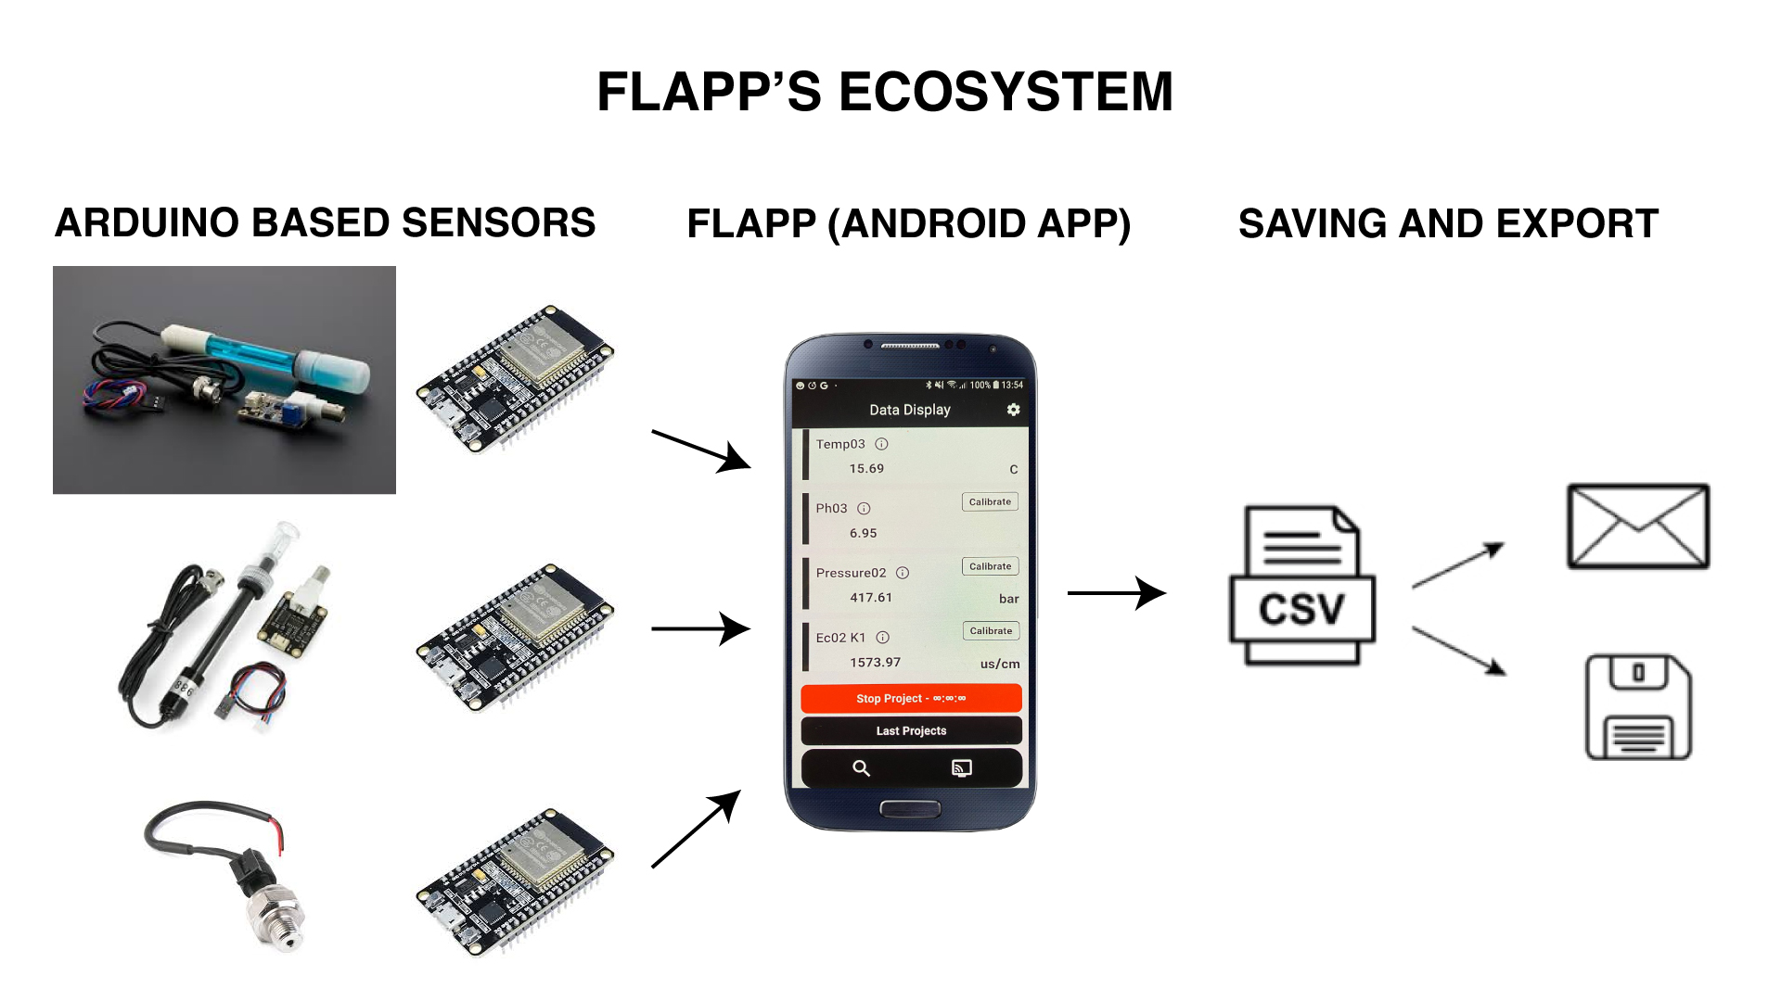



FLAPP’S ECOSYSTEM
ARDUINO BASED SENSORS
FLAPP (ANDROID APP)
SAVING AND EXPORT DATA
pH
EC
ORP
Pressure
Weight
Temperature
CSV file

Slide 2
pH
EC
Pressure
Weight
Temperature

Slide 3
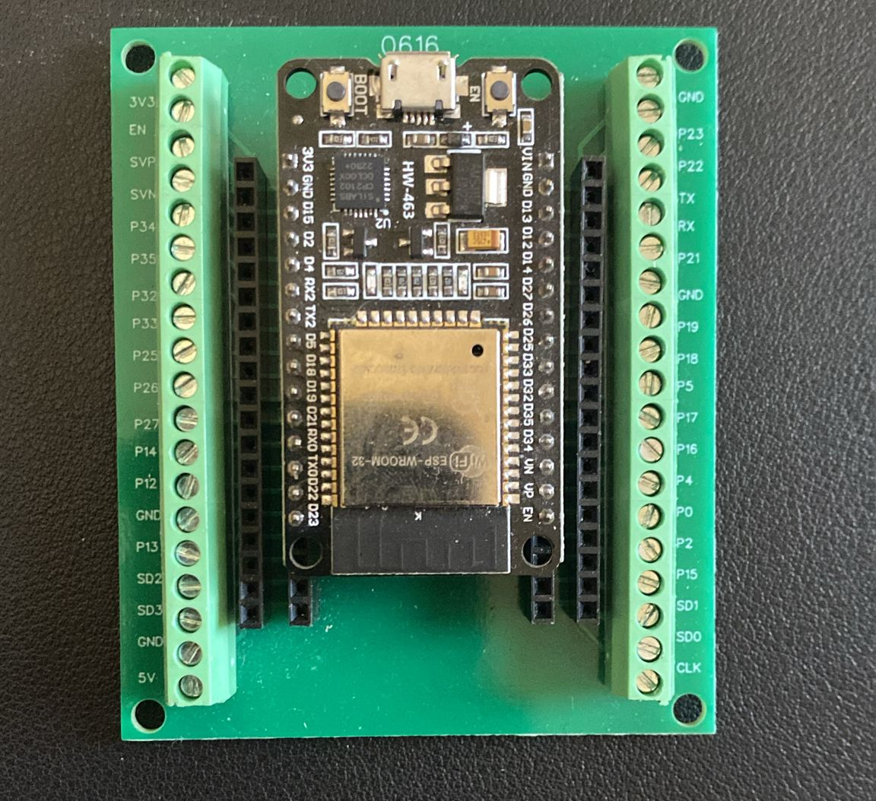

Slide 4
FLAPP’S ECOSYSTEM
Pressure
Temperature
pH
EC
CSV file
10.2 g
Weight

Slide 5
FLAPP’S ECOSYSTEM
Pressure detector
EC detector
Pressure
Temperature detector
pH detector
pH
EC
Weight detector
CSV file
Temperature
10.2 g
Weight

Slide 6
FLAPP’S ECOSYSTEM
Electronic system
Pressure
Electronic system
Temperature
Electronic system
Electronic system
pH
EC
CSV file
Electronic system
10.2 g
Weight

Slide 7
Pressure
Temperature
pH
EC
10.2 g
Weight

